Slide 1


Focus Web Developer
Week 2 – Lesson 3
Notes:
Welcome your class, think about what is the hook to engage your students right out of the starting gate.

Slide 2
Lesson Topics
HTML 5 & CSS3 Practice Continued
Notes:
Pre-test
Two-way learning

Slide 3
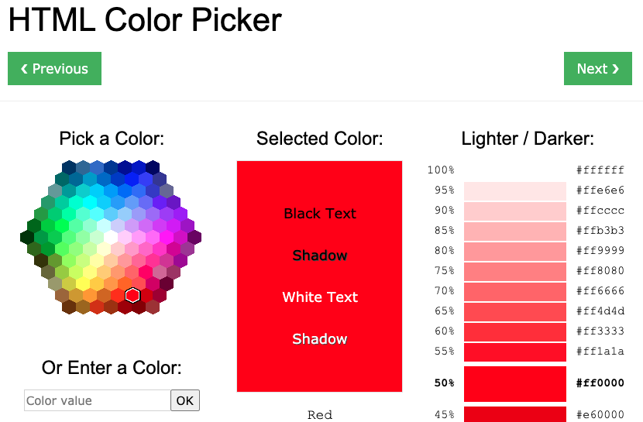
Quick tip!
Bookmark this URL: https://www.w3schools.com/colors/colors_picker.asp
You can get what colour you want in multiple formats!

Slide 4
General Note
If you don’t know what a part of your code is doing, then please ASK!
We are trying to establish a strong foundation in HTML and CSS, so please don’t include code that you don’t know what it’s doing.
Eventually, you will begin copying, pasting and citing other programmers’ code, but this is under the assumption that you understand everything that is going on in the code!

Slide 5
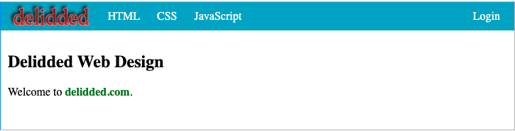
Activity 1 Introduction
Create the following webpage using HTML and CSS
these are all different links
Activity 1 is from https://www.delidded.com/html-css-practice-test/html-css-practice-problems/

Slide 6
Activity 1 Introduction
HTML elements and attributes used (in addition to boiler plate):
CSS properties used:
margin (right, left, etc)
background-color
color
height
border
padding
display
vertical-align
line-height
text-decoration
float
font-weight
Elements
<div>
<a>
<img>
<ul>
<li>
<span>
<p>
Attributes
class
id
href
src
alt
height
CSS Properties Reference https://www.w3schools.com/cssref/
Activity 1 is from https://www.delidded.com/html-css-practice-test/html-css-practice-problems/
Notes:
Might be better to make these into tables.

Slide 7
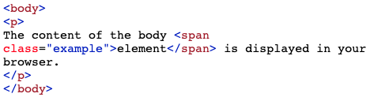


HTML <span> element
New HTML elements used:
<span> – Defines an in-line section in a document
- often used around text that you want to style in your CSS
HTML
CSS
Web Browser
Activity 1 is from https://www.delidded.com/html-css-practice-test/html-css-practice-problems/
Notes:
Span link: https://www.w3schools.com/tags/tag_span.asp
this slide should be cleaned up visually

Slide 8
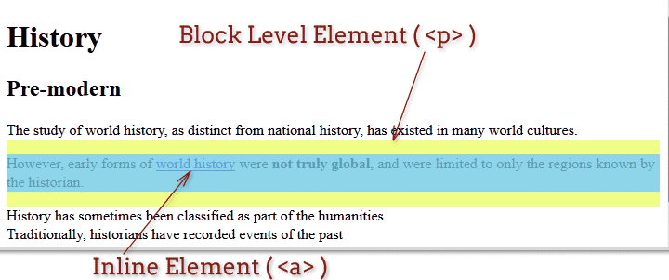
Inline Elements vs. Block Level Elements
Activity 1 is from https://www.delidded.com/html-css-practice-test/html-css-practice-problems/

Slide 9
New CSS Properties
New CSS properties used:
display - Specifies how a certain HTML element should be displayed
vertical-align - Sets the vertical alignment of an element
line-height - Sets the line height
text-decoration - Specifies the decoration added to text
float - Specifies whether or not a box should float
CSS Properties Reference https://www.w3schools.com/cssref/
Activity 1 is from https://www.delidded.com/html-css-practice-test/html-css-practice-problems/
Notes:
Display link: https://www.w3schools.com/cssref/pr_class_display.asp
vertical-algin link: https://www.w3schools.com/cssref/pr_pos_vertical-align.asp
line-height link: https://www.w3schools.com/cssref/pr_dim_line-height.asp
text-decoration link: https://www.w3schools.com/cssref/pr_text_text-decoration.asp
float link: https://www.w3schools.com/cssref/pr_class_float.asp
Click on each of these links and go through what each property does by showing them. Be sure to show students the “Play It” feature

Slide 10
Activity 1 Instructions
Requirements:
Use HTML and CSS to make identical format (except the colours and exact font type - do whatever you want!)
Save the file in your Activity 1
Use <title>Week 2 Day 3 Activity 1</title> in the head
open all links in new tabs
logo image src = https://www.delidded.com/logo.png
logo image link = https://media.giphy.com/media/geYwtodB9AiI0/giphy.gif
HTML link = https://www.w3schools.com/html/html_intro.asp
CSS link = https://www.w3schools.com/Css/css_intro.asp
JavaScript link = https://www.w3schools.com/js/js_intro.asp
Login link = https://zapatopi.net/treeoctopus/
delidded.com is not a link
Hints:
use <div> to make divisions for the top bar and main part
use classes and id’s
the top bar is a modified version of an unordered list
use <span> to modify the “delidded.com” text
Activity 1 is from https://www.delidded.com/html-css-practice-test/html-css-practice-problems/

Slide 11
Activity 1 Options
Some of us may be feeling overwhelmed at the thought of this project, so here are some options:
Try the whole thing on your own
First code HTML with a linked CSS file to create the webpage (shown on the next slide) and then make the CSS file
Copy the HTML code only, look at it in your web browser and then you make the CSS file to change how it looks without changing the HTML file
Your instructor will “code” the HTML file with you in real-time and then let you try the CSS on your own
Activity 1 is from https://www.delidded.com/html-css-practice-test/html-css-practice-problems/

Slide 12
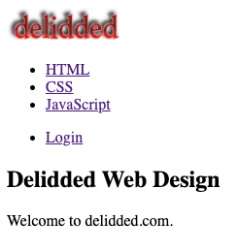
Activity 1 Option 2
This is what the HTML file should look like without a linked CSS file. Try to create this webpage first, then make your CSS file (and add things to your HTML where appropriate).
Activity 1 is from https://www.delidded.com/html-css-practice-test/html-css-practice-problems/

Slide 13
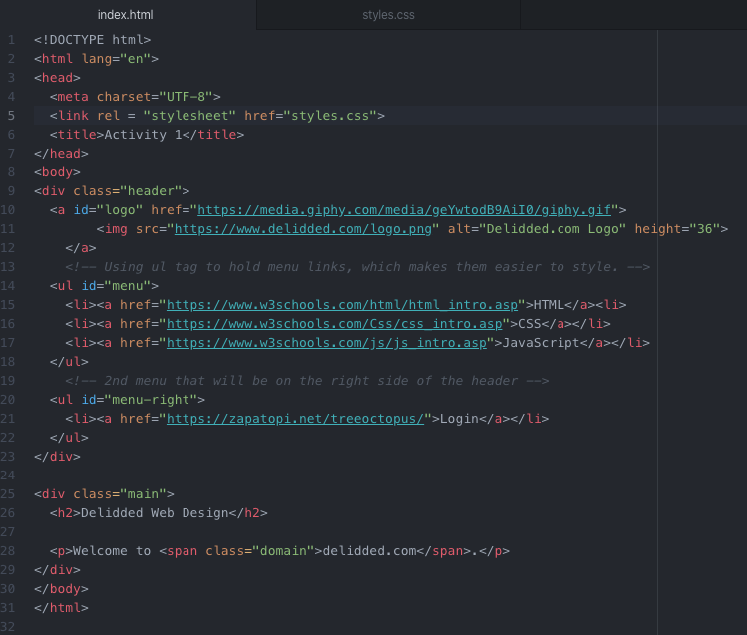
Activity 1 Solution (HTML)
Activity 1 is from https://www.delidded.com/html-css-practice-test/html-css-practice-problems/

Slide 14
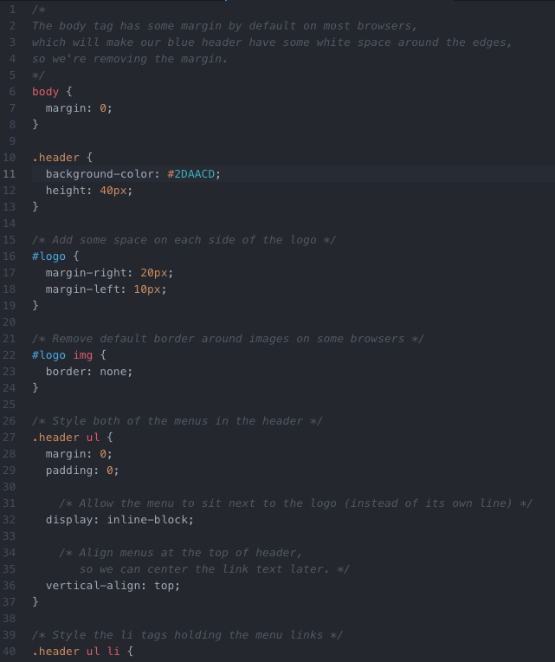
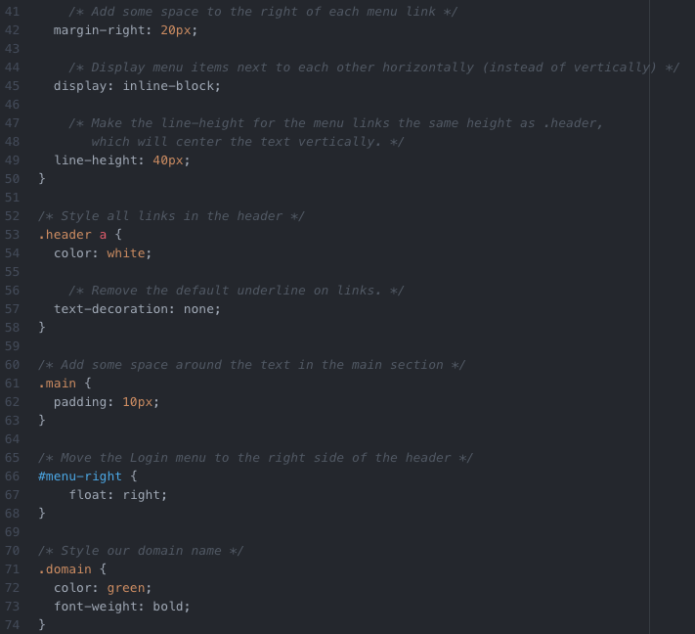
Activity 1 Solution (CSS)
Activity 1 is from https://www.delidded.com/html-css-practice-test/html-css-practice-problems/

Slide 15
Activity 1 Challenge
Once you have checked your code with your partner, try the challenge.
Duplicate your index.html file from Activity 1 into a new folder named “Activity 1 Challenge”
Challenges:
make the each button change colour when you hover over them
make the text in the buttons change to a different colour once they’ve been used
add different animations to each button
Activity 2 is from https://www.delidded.com/html-css-practice-test/html-css-practice-problems/

Slide 16
Gathering Time
Gathering Time is a time for check-in.
Notes:
Instructors Notes:
Introduce the concept of Gathering Time, which will be used throughout the program.
The sharing stone can be just a stone someone in the class wants to use or one from outside.
It just reminds everyone to listen when the person with the stone talks, so everyone has an opportunity to listen.
Chairs only
Someone from the host Nation can be offered to start the check-in first. If no one is interested then someone else in the group, or the Instructor, will be offered to start it next.

Slide 17
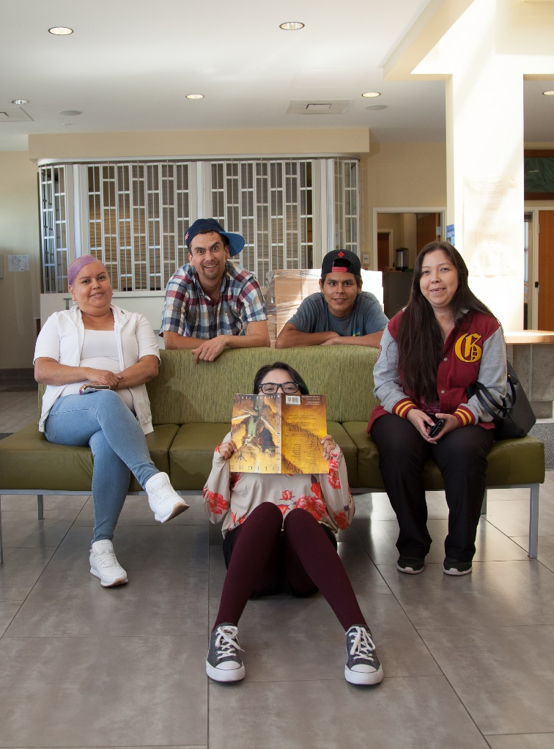
Class Wrap-up
How was your day?
How’s your website coming along?
Are you excited to add some colour?
Notes:
Post test: provide the students with feedback about the day, review the day.
End of the day Q/A
Were the day’s goals met (reference slide 2)?
Transition: what’s coming up tomorrow?

